Slide 1
cmd > Fundamentals
Various
ICT40120 Certificate IV in Information Technology
IP4RIoT
ICTICT449 | Use version control systems in development environments
ICTPRG430 | Introductory object-oriented techniques

Slide 2
Session Contents
Preamble: operating systems
Command line: what, why, when
Common terminal emulators and shells
Practice

Slide 3
Warm up
Discuss the following as a group:
What is an operating system?
List operating systems you are familiar with
Give examples of some things operating systems do
How do you typically interact with the operating system?
Common applications on Windows and other operating systems
Notes:
An operating system (OS) is the foundational software that manages computer hardware and software resources, providing common services for computer programs. It acts as a mediator between the user and the computer hardware, facilitating the execution of all kinds of programs, from basic system processes to user-initiated applications.
Operating systems perform various essential functions such as file management, process management, memory management, and handling input/output operations. Examples of operating systems include Windows, Linux, MacOS, and Unix.

Slide 4

terminals and shells
Introduction to the command line

Slide 5
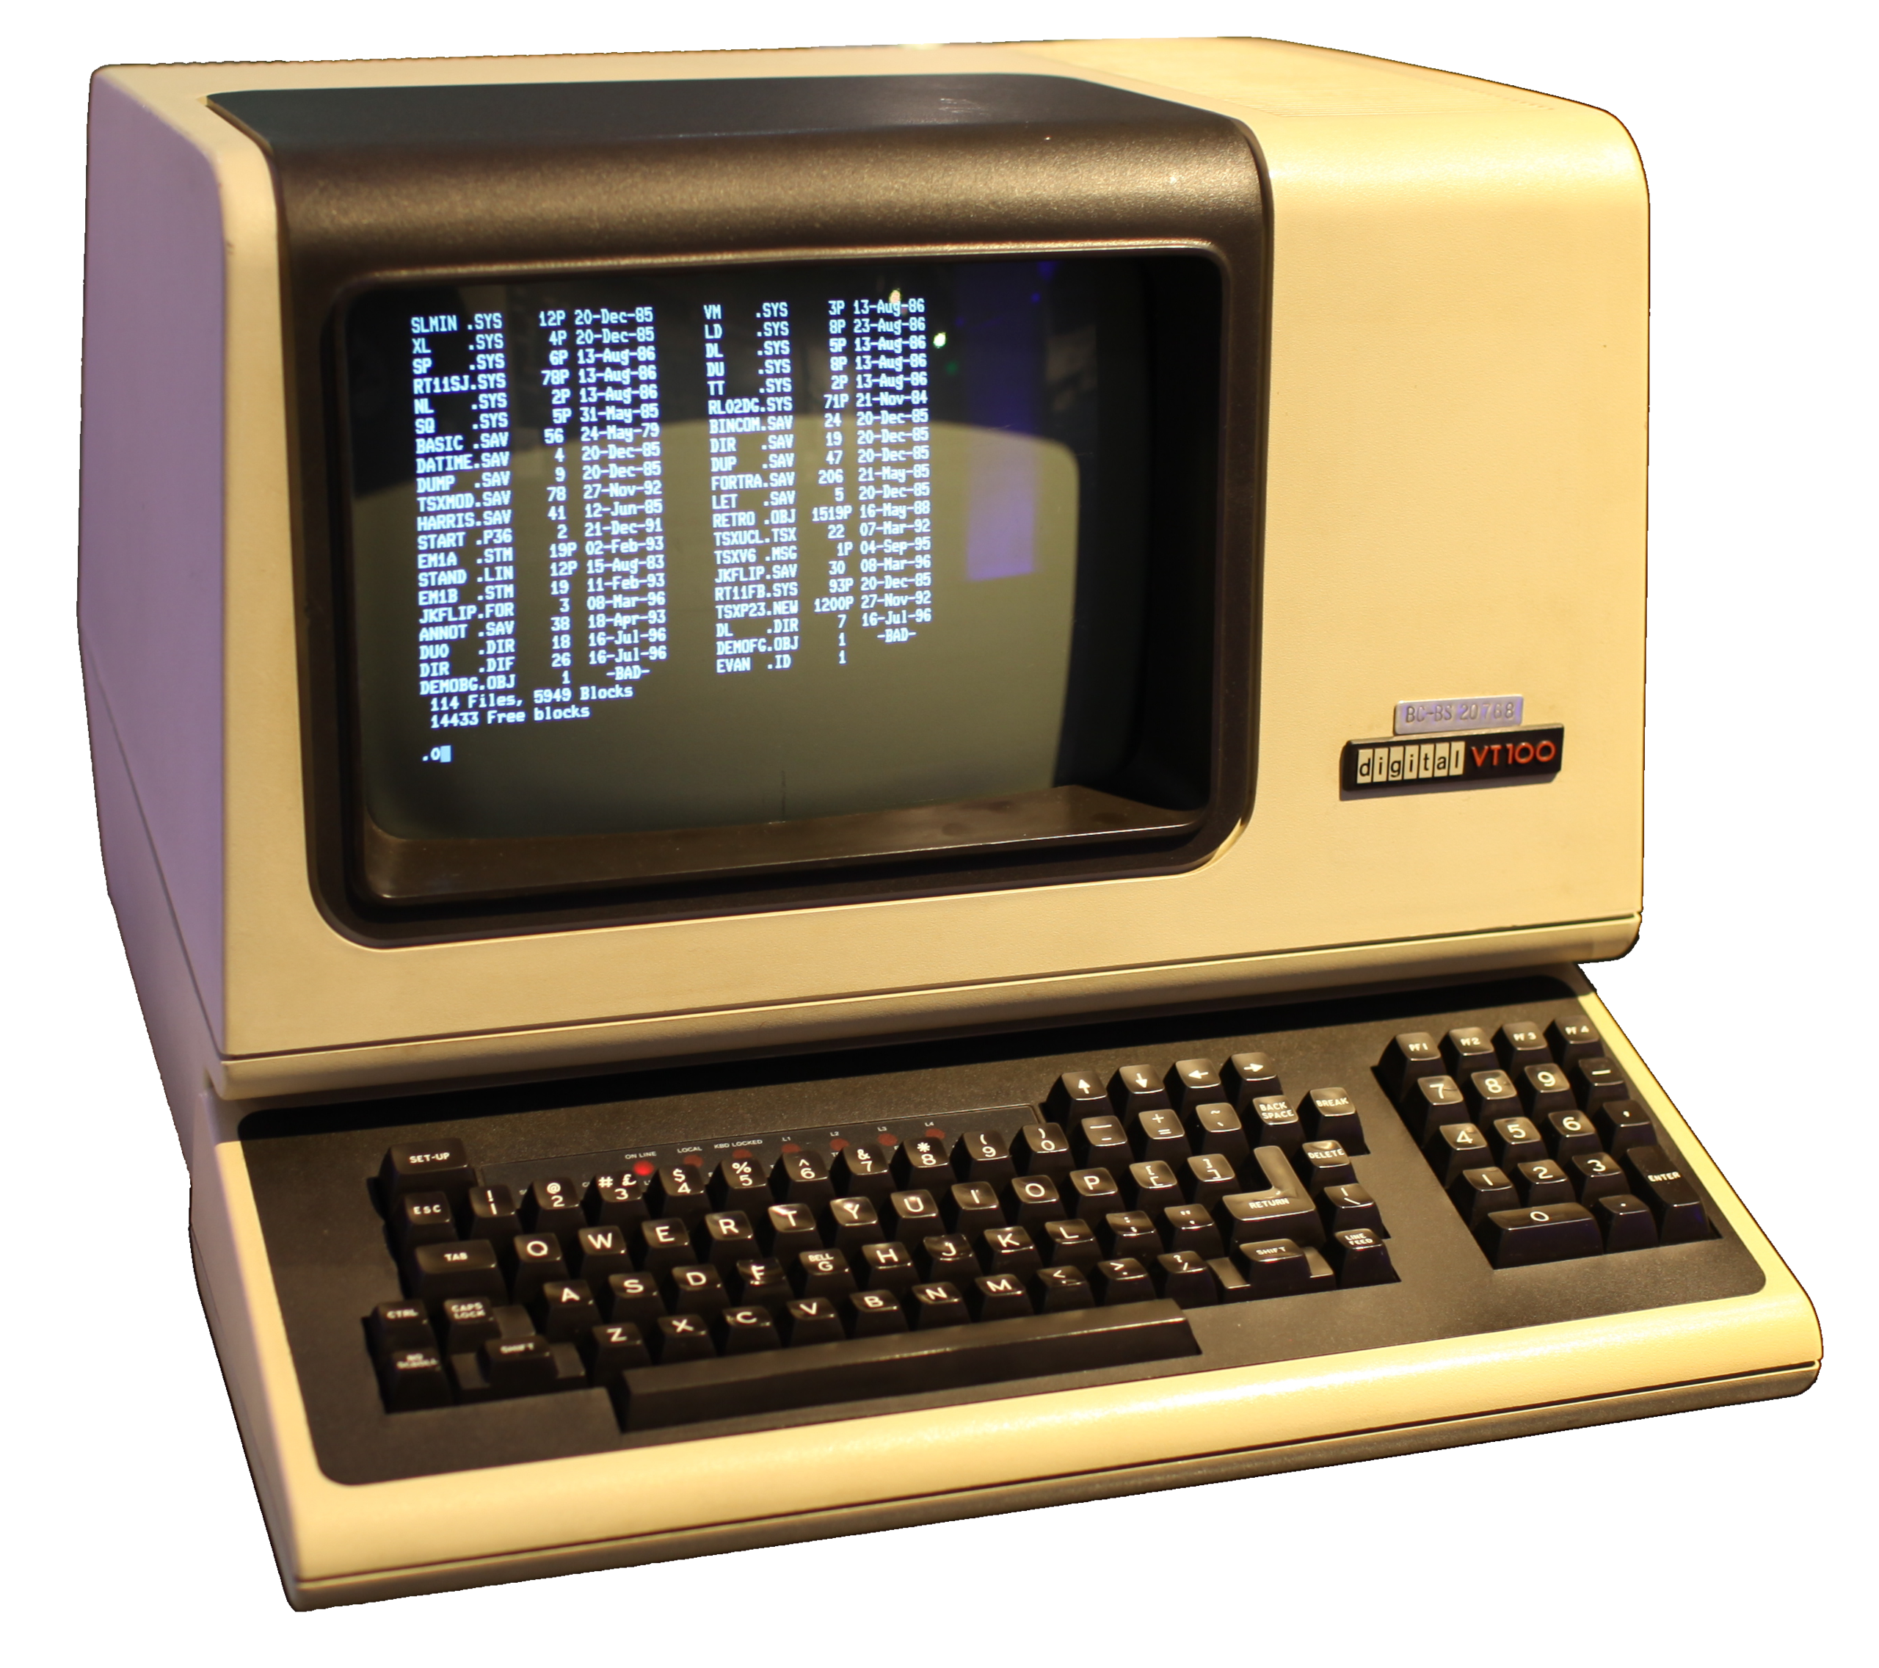
Terminals
IBM VT100
History
Terminals used to be how you connected to mainframes
It referred to the workstation which had a simple input (e.g. keyboard)
And output (e.g. a monitor)
So why do care about them today?
Notes:
Image: By Gorthmog - This file has been extracted from another file, CC BY-SA 4.0, https://commons.wikimedia.org/w/index.php?curid=78497051 Generated: The concept of terminals originated in the early days of computing, when computers were large, expensive, and occupied entire rooms. During the 1960s and 1970s, users interacted with these mainframe computers via terminals. These terminals were hardware devices consisting of a keyboard for input and a screen for output. They served as the interface through which users could send commands to the computer and receive responses. This setup was critical in environments where multiple users needed to access a central computing resource simultaneously.
As computing evolved, particularly with the advent of personal computing in the late 1970s and early 1980s, the need for physical terminals connected to mainframes diminished. However, the concept of the terminal persisted, giving rise to terminal emulators.

Slide 6
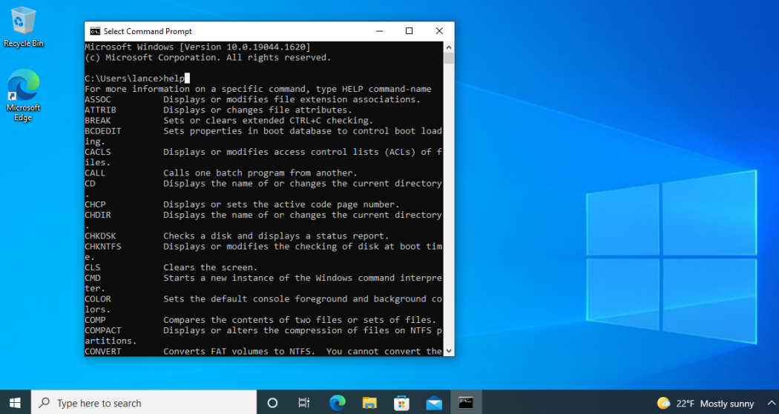
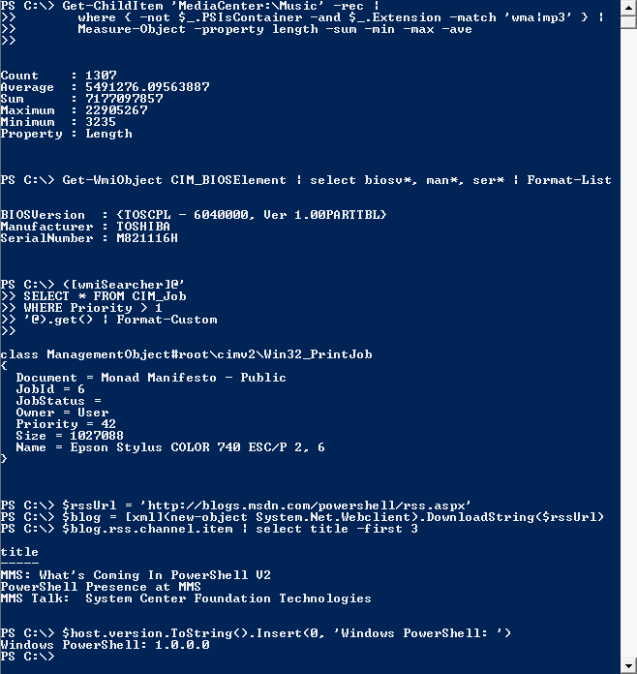
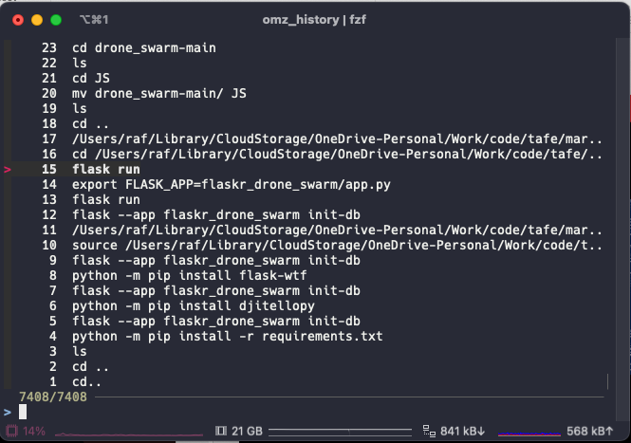
Modern terminal emulators
Notes:
1. Windows Command Prompt
Platform: Windows
Description: The Command Prompt is a native Windows terminal emulator that provides a command-line interface to execute batch commands, access system tools, and perform various tasks. While not as feature-rich as some third-party emulators, it remains widely used for its direct integration with the Windows operating system.
2. PowerShell
Platform: Windows, with versions available for Linux and MacOS
Description: PowerShell extends beyond the capabilities of the traditional Command Prompt by offering a more powerful scripting language and a comprehensive command-line shell. It integrates deeply with the Windows OS and the .NET framework, providing a robust environment for automation and configuration management.
3. Terminal (macOS)
Platform: MacOS
Description: Terminal.app is the default terminal emulator for MacOS, offering users access to the Unix part of MacOS via a command-line interface. It supports various Unix commands and utilities, making it a powerful tool for MacOS users to perform advanced system operations.
4. GNOME Terminal
Platform: Linux (GNOME Desktop Environment)
Description: GNOME Terminal is the default terminal emulator for the GNOME desktop environment, commonly found in distributions like Ubuntu and Fedora. It supports tabs, customizable shortcuts, and themes, providing a rich set of features for Linux users.
5. Konsole
Platform: Linux (KDE Desktop Environment)
Description: Konsole is the standard terminal emulator for the KDE desktop environment. It features tabbed browsing, split views, and extensive customization options, catering to a wide range of user preferences and workflows.
6. iTerm2
Platform: MacOS
Description: iTerm2 is a third-party terminal emulator for MacOS that offers features not available in the default Terminal.app. These include split panes, search, advanced customization, and more, making it a popular choice among developers and power users on MacOS.
7. PuTTY
Platform: Windows, with unofficial ports to other systems
Description: Originally developed for Windows, PuTTY is a lightweight, open-source terminal emulator primarily used for SSH and telnet connections to remote servers. Despite its simplicity, it remains a fundamental tool for network administrators and developers working in Windows environments.

Slide 7
Terminals - summary
Think of modern terminals as the software analogue of the physical terminals of the past
They give you the box from which to communicate with some “server” using a command line interface
The command line interface allows you to talk to the operating system using commands and is typically called a shell…

Slide 8
Shell
A shell is an interface to an operating system
Typically, when we refer to a shell we refer to a command line interface. Though graphical interfaces can sometimes be shells too
A command line shell interprets commands
It is much like an interpreted programming language with certain behaviors that make it well-suited for working with the OS and its processes

Slide 9
Common shells
Windows:
Command Prompt (same name as the terminal)
PowerShell (PS) (same name as the default terminal)
Different syntax (some compatibility through aliasing)
Everything else (*NIX):
Bourne Again Shell (bash)
Z Shell (zsh)
Korn Shell (ksh)
Syntax is almost identical “Portable Operating System Interface (POSIX) compliant”
Notes:
Windows Shells:
Command Prompt:
Referred to as cmd.exe, it's a command-line interpreter on Windows systems.
Command Prompt acts as both a shell and a terminal, meaning the environment where commands are entered is named the same as the shell itself.
PowerShell:
An advanced shell provided by Microsoft with more features compared to Command Prompt.
PowerShell is both a scripting environment and a command-shell interface.
It uses a different command syntax, but aliases can be used to make some commands resemble traditional cmd.exe commands.
Unix-Like Shells:
Bash (Bourne Again SHell):
Default shell on most Linux distributions and MacOS.
Offers scripting capabilities and interactive use.
Zsh (Z Shell):
Similar to Bash with extended features like improved autocomplete and themes.
Often used with Oh My Zsh, which provides additional functionality.
Ksh (Korn Shell):
Known for being a middle ground between Bash and Zsh in terms of features.
It is POSIX-compliant and offers advanced scripting capabilities.
Syntax Similarities:
Bash, Zsh, and Ksh have almost identical syntax due to their roots in the Bourne Shell.
Differences exist, but they are generally subtle and pertain to advanced features or scripting nuances.

Slide 10
Shell Scripting
Shell commands can be combined together in a text file into a shell script
A shell script executes all the commands in a file
Shell scripting languages support control flows and programming language features
Nevertheless, they are primarily used to automate work with the operating system

Slide 11
Advantages and disadvantages
Advantages:
Repeatable, fast, reliable
Commands very rarely change (contrast with GUIs)
Disadvantage:
Discoverability!

Slide 12
Discoverability
Generative AI (e.g. Microsoft Copilot, ChatGPT, Claude, or DeepSeek) is very good at figuring out commands
Prompt should include operating system, shell, and what you want to do. Ask for just the command or an explanation (depending on what you want)
Try to memorize (by writing out) commands you find yourself using often, but you’ll never know all commands, and that is fine

Slide 13
Example prompts
In Windows 11 using PowerShell, how do I copy files ending with .txt from one folder to another? Respond with just the command.
I am a beginner in using the command line. Can you help me understand what the following command does in zsh on MacOS: rm –rf .git/?

Slide 14




Windows – an odd duck
Windows isn’t like any other operating systems (think Mac, Linux, Android, iPhone OS, anything).
While PowerShell is available on other platforms, take-up has been limited.
On Windows, we can create a *NIX environment using Minimal GNU for Windows (MinGW) or Windows Subsystem for Linux (WSL).
Git by default installed Git Bash, which is a bash shell that uses MinGW to provide a *nix-like environment on Windows.

Slide 15
How files and folders are represented
Modern file systems use a tree structure
Relative path
Absolute path
Hierarchy represented with separators:
Backslash (\) on Windows
Forward slash (/) on everything else
Root folder:
Drive letter followed by colon (e.g. C:\) on Windows
Initial forward slash (/) on everything else

Slide 16
Aspect | *nix | Windows (cmd) | Similarities/Notes
Root Directory | / | C:\ (for the C: drive) | The root directory is the top-most directory in the filesystem hierarchy.
Path Separator | / (forward slash) | \ (backslash) | Both are used to separate directories in a filesystem path.
Directory Representation | Standard directories and files | Standard directories and files | Both systems use directories to organize files.
Current Directory | . | . | Represents the current working directory in both systems.
Parent Directory | .. | .. | Represents the directory one level up in the hierarchy in both systems.
Home Directory | ~ (tilde, for the user's home directory) | %USERPROFILE% or C:\Users\username | Special designation for the user's main directory.

Slide 17
Aspect | *nix | Windows (cmd) | Similarities/Notes
Drives | Mounted like folders found under /mnt | Designated by drive letters (e.g., C:) | *nix mounts different devices into the single directory tree, while Windows assigns a unique drive letter to each storage device.
File Case Sensitivity | Case-sensitive | Case-insensitive | *nix treats file and File as different entities, whereas Windows does not.
Executable Files | Denoted by permissions, no extension required | Often have .exe extension | In *nix, a file is made executable by changing its permissions. In Windows, executables typically have an .exe extension.
Hidden Files | Prefixed with . (e.g., .hiddenfile) | Typically system files or with Hidden attribute, no prefix required | Both systems support the concept of hidden files, but the method of hiding differs.

Slide 18
Revise
How do you know a path is relative on Windows/*nix?
What is the root folder on Windows versus *nix?
What are the different separators between folders?
How many directory trees are there on Windows? *Nix?

Slide 19
Key shell commands (Windows)
List Directory Contents: dir
Change Directory: cd <directory>
Create a New Directory: mkdir <directory>
Delete a File: del <filename>
Clear the Screen: cls

Slide 20
Key shell commands (*nix)
List Directory Contents: ls
Change Directory: cd <directory>
Create a New Directory: mkdir <directory>
Remove a File or Directory: rm <filename> or rm -r <directory>
Clear the Screen: clear

Slide 21
Practice Exercise
Navigate: Use cd to navigate to your Documents folder.
Create: Make a new folder named your-initials-practice.
List: List the contents of your current directory to confirm the creation of your new folder.
Remove: Delete a file or folder you've created for practice (make sure it's something you won't miss!).
Repeat in Git Bash; Repeat with Absolute and Relative paths

Slide 22
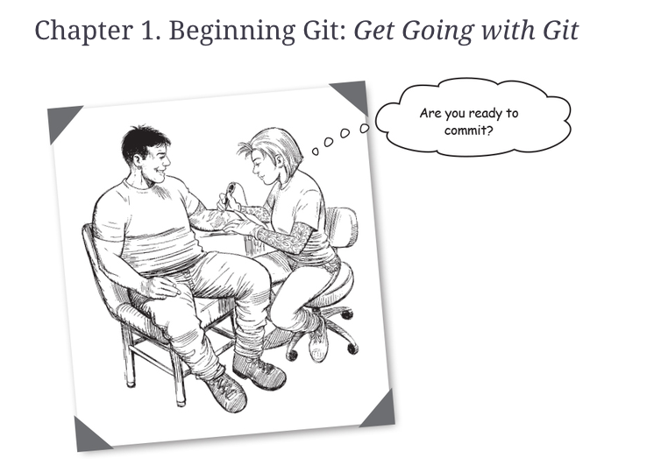
Further reading: required for next week!
https://learning.oreilly.com/library/view/head-first-git/9781492092506/ch01.html
Complete the exercises in the chapter!

